Slide 1
Measles and Rubella
Global Update
August 2025

Slide 2
Distribution list
This report is posted on the WHO Immunization data portal (https://immunizationdata.who.int/global?topic=Provisional-measles-and-rubella-data&location=) and distributed by email on a monthly basis.
To join the distribution list, please send an email to Sebastien Antoni (antonis@who.int)

Slide 3
Disclaimer
Please note that all data contained within is provisional. The number of cases of measles and rubella officially reported by a member state is only available by July of each year (through the joint WHO UNICEF annual data collection exercise). If any numbers from this provisional data are quoted, they should be properly sourced with a date (i.e. "provisional data based on monthly data reported to WHO (Geneva) as of August 2025"). For official data from 1980-2024, please visit our website.

Slide 4
Data sources and limitations

Slide 5
Measles

Slide 6
Number of reported measles cases by WHO Region
2025
Region | Member States* | Suspected MR cases | Measles cases | Clin | Epi | Lab | Date Received
AFR | 42/47 | 58,173 | 28,434 | 6,924 | 10,335 | 11,175 | 2025-08
AMR | 31/35 | 19,541 | 9,045 | 5 | 2,192 | 6,848 | 2025-08
EMR | 20/21 | 80,311 | 49,605 | 24,693 | 4,751 | 20,161 | 2025-08
EUR | 47/53 | 37,197 | 27,266 | 4,719 | 5,182 | 17,365 | 2025-08
SEAR | 10/10 | 62,298 | 12,857 | 5,442 | 2,211 | 5,204 | 2025-08
WPR | 23/28 | 42,566 | 9,892 | 2,782 | 497 | 6,613 | 2025-08
Total | 173/194 | 300,086 | 137,099 | 44,565 | 25,168 | 67,366
Region | Jan | Feb | Mar | Apr | May | Jun | Jul | Aug | Sep | Oct | Nov | Dec
AFR | 4,851 | 5,633 | 6,381 | 4,743 | 3,564 | 2,506 | 756 | 0 | 0 | 0 | 0 | 0
AMR | 211 | 434 | 1,221 | 2,502 | 2,150 | 1,621 | 906 | 0 | 0 | 0 | 0 | 0
EMR | 6,704 | 7,334 | 9,260 | 9,090 | 8,698 | 5,527 | 2,992 | 0 | 0 | 0 | 0 | 0
EUR | 4,893 | 4,439 | 4,596 | 5,160 | 4,926 | 3,094 | 158 | 0 | 0 | 0 | 0 | 0
SEAR | 1,431 | 1,703 | 2,330 | 2,468 | 1,975 | 1,575 | 1,375 | 0 | 0 | 0 | 0 | 0
WPR | 2,425 | 2,255 | 1,848 | 1,389 | 1,521 | 454 | 0 | 0 | 0 | 0 | 0 | 0
Total | 20,515 | 21,798 | 25,636 | 25,352 | 22,834 | 14,777 | 6,187 | 0 | 0 | 0 | 0 | 0
2024
Region | Member States* | Suspected MR cases | Measles cases | Clin | Epi | Lab | Date Received
AFR | 43/47 | 153,308 | 86,127 | 15,884 | 51,811 | 18,432 | 2025-08
AMR | 33/35 | 17,240 | 463 | 0 | 53 | 410 | 2025-08
EMR | 21/21 | 164,426 | 96,713 | 52,179 | 6,207 | 38,327 | 2025-08
EUR | 52/53 | 149,120 | 127,325 | 21,812 | 20,130 | 85,383 | 2025-08
SEAR | 10/10 | 133,186 | 29,662 | 8,150 | 6,639 | 14,873 | 2025-08
WPR | 26/28 | 91,820 | 19,202 | 7,893 | 986 | 10,323 | 2025-08
Total | 185/194 | 709,100 | 359,492 | 105,918 | 85,826 | 167,748
Region | Jan | Feb | Mar | Apr | May | Jun | Jul | Aug | Sep | Oct | Nov | Dec
AFR | 13,630 | 15,801 | 19,233 | 11,624 | 7,782 | 4,419 | 2,969 | 2,331 | 2,501 | 2,270 | 2,207 | 1,360
AMR | 24 | 49 | 103 | 47 | 18 | 19 | 41 | 38 | 37 | 33 | 44 | 10
EMR | 13,513 | 15,485 | 15,739 | 10,912 | 10,914 | 7,073 | 5,088 | 3,559 | 3,838 | 3,695 | 3,272 | 3,625
EUR | 29,073 | 24,115 | 20,549 | 15,701 | 12,921 | 9,448 | 5,177 | 2,411 | 1,501 | 1,392 | 2,018 | 3,019
SEAR | 2,769 | 3,052 | 4,039 | 2,942 | 2,194 | 1,345 | 1,845 | 2,209 | 2,574 | 2,917 | 2,237 | 1,539
WPR | 2,142 | 1,791 | 1,927 | 1,677 | 1,661 | 1,211 | 924 | 1,355 | 1,360 | 1,712 | 1,816 | 1,626
Total | 61,151 | 60,293 | 61,590 | 42,903 | 35,490 | 23,515 | 16,044 | 11,903 | 11,811 | 12,019 | 11,594 | 11,179
Notes: Based on data received 2025-08 - This is surveillance data, hence for the last month, the data may be incomplete. * Member States Reporting / Total Member States in Region

Slide 7
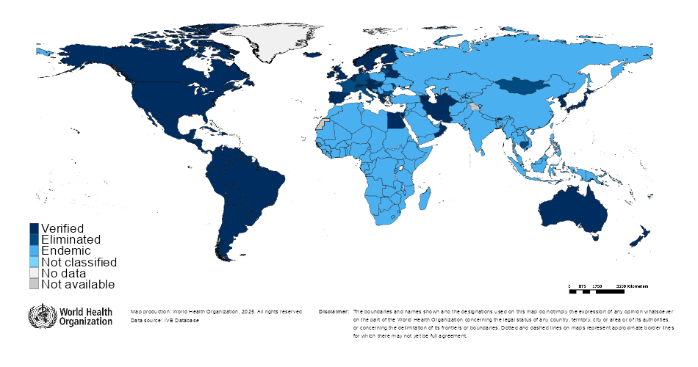

Measles/rubella verification of elimination
Measles
Region | Member States | Verified | % Verified | Eliminated | Endemic | Not classified
AFR | 47 | 0 | 0 | 0 | 47 | 0
AMR | 35 | 34 | 97 | 0 | 0 | 1
EMR | 21 | 4 | 19 | 0 | 17 | 0
EUR | 53 | 33 | 62 | 8 | 12 | 0
SEAR | 10 | 4 | 40 | 0 | 6 | 0
WPR | 28 | 6 | 21 | 15 | 7 | 0
GLOBAL | 194 | 81 | 42 | 23 | 89 | 1
Rubella
Region | Member States | Verified | % Verified | Eliminated | Endemic | Not classified
AFR | 47 | 0 | 0 | 0 | 47 | 0
AMR | 35 | 34 | 97 | 0 | 0 | 1
EMR | 21 | 4 | 19 | 0 | 17 | 0
EUR | 53 | 50 | 94 | 0 | 0 | 3
SEAR | 10 | 5 | 50 | 1 | 4 | 0
WPR | 28 | 5 | 18 | 16 | 7 | 0
GLOBAL | 194 | 98 | 51 | 17 | 75 | 4
Notes: Based on data available at WHO HQ as of 2025-08-18 . Terms used on this slide refer to the global framework for the verification of measles and rubella elimination. These terms might differ from those used by WHO Regional Offices. Verified = Elimination verified by Regional Verification Commitee (RVC); Eliminated = Eliminated transmission but no RVC verification yet.

Slide 8
Measles case distribution by month and WHO Region (2020-2025)
2020
2021
2022
2023
2024
2025
93,840 cases
59,619 cases
174,340 cases
321,876 cases
359,492 cases
137,099 cases
60,000
40,000
AFR
AMR
EMR
EUR
SEAR
WPR
20,000
0
Jan
Feb
Mar
Apr
May
Jun
Jul
Aug
Sep
Oct
Nov
Dec
Jan
Feb
Mar
Apr
May
Jun
Jul
Aug
Sep
Oct
Nov
Dec
Jan
Feb
Mar
Apr
May
Jun
Jul
Aug
Sep
Oct
Nov
Dec
Jan
Feb
Mar
Apr
May
Jun
Jul
Aug
Sep
Oct
Nov
Dec
Jan
Feb
Mar
Apr
May
Jun
Jul
Aug
Sep
Oct
Nov
Dec
Jan
Feb
Mar
Apr
May
Jun
Jul
Aug
Sep
Oct
Nov
Dec
Based on data received 2025-08 - Data Source: IVB Database - This is surveillance data, hence for the last month(s), the data may be incomplete.

Slide 9
Measles case distribution by month and WHO Region (2017-2025)
2017
2018
2019
2020
2021
2022
2023
2024
2025
168,190 cases
276,157 cases
541,401 cases
93,840 cases
59,619 cases
174,340 cases
321,876 cases
359,492 cases
137,099 cases
125,000
100,000
AFR
75,000
AMR
EMR
EUR
SEAR
50,000
WPR
25,000
0
May
Aug
Sep
May
Aug
Sep
May
Aug
Sep
May
Aug
Sep
May
Aug
Sep
May
Aug
Sep
May
Aug
Sep
May
Aug
Sep
May
Aug
Sep
Jan
Feb
Apr
Jun
Jul
Oct
Jan
Apr
Jun
Jul
Oct
Jan
Apr
Jun
Jul
Oct
Jan
Apr
Jun
Jul
Oct
Jan
Apr
Jun
Jul
Oct
Jan
Apr
Jun
Jul
Oct
Jan
Apr
Jun
Jul
Oct
Jan
Apr
Jun
Jul
Oct
Jan
Apr
Jun
Jul
Oct
Mar
Nov
Dec
Feb
Mar
Nov
Dec
Feb
Mar
Nov
Dec
Feb
Mar
Nov
Dec
Feb
Mar
Nov
Dec
Feb
Mar
Nov
Dec
Feb
Mar
Nov
Dec
Feb
Mar
Nov
Dec
Feb
Mar
Nov
Dec
Based on data received 2025-08 - Data Source: IVB Database - This is surveillance data, hence for the last month(s), the data may be incomplete.

Slide 10
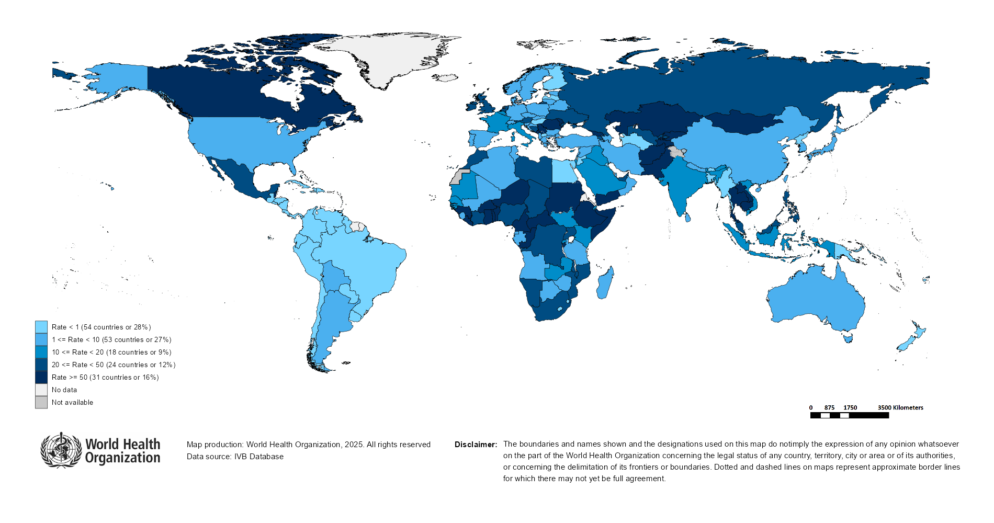
Measles Incidence Rate per Million (12M period)
Highest incidence rates | Highest incidence rates | Highest incidence rates
Country | Cases | Rate
Kyrgyzstan | 10462 | 1,455.88
Yemen | 30568 | 753.22
Romania | 9875 | 519.32
Mongolia | 1199 | 344.98
Afghanistan | 11142 | 261.26
Tajikistan | 2177 | 205.55
Georgia | 712 | 186.99
Kazakhstan | 3112 | 151.12
Serbia | 900 | 133.61
Thailand | 7526 | 105.01
Notes: Based on data received 2025-08 - Surveillance data from 2024-07 to 2025-06 - Incidence: Number of cases / population * 1,000,000 - Population data: World population prospects, 2019 revision

Slide 11
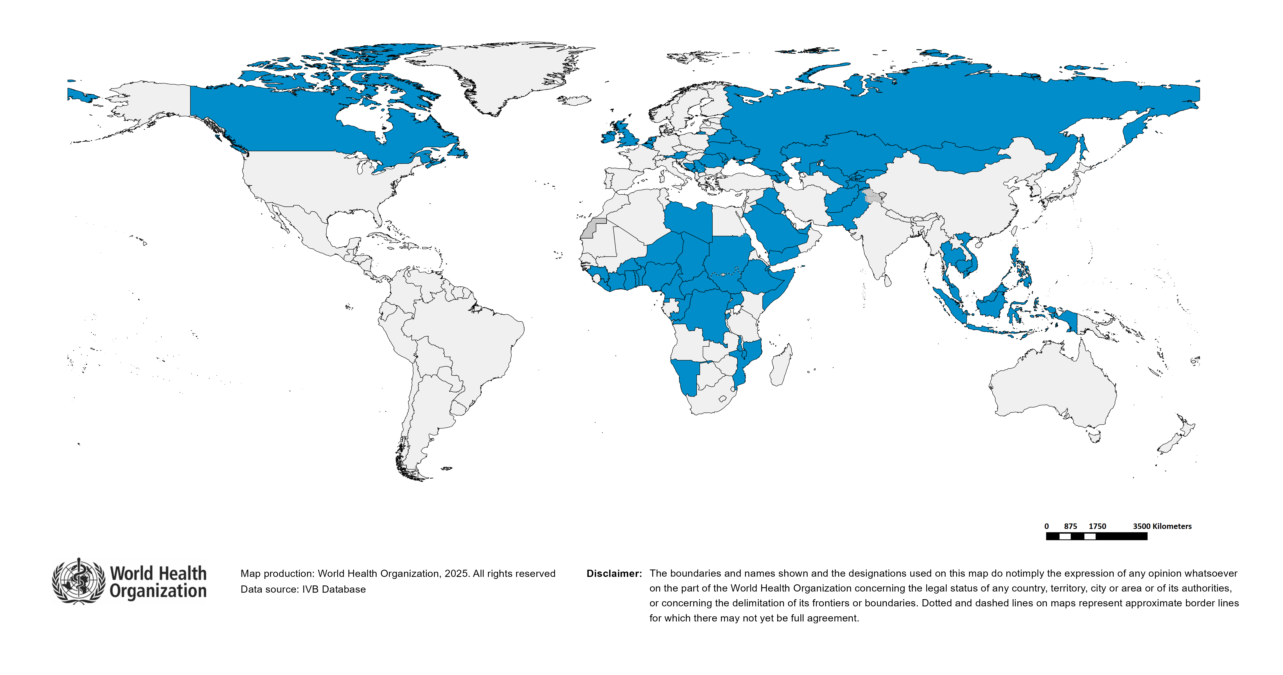
Immunization Agenda 2030 - Impact Goal 1.3
Countries provisionally meeting the large or disruptive outbreaks definition - Data from 2024-04 to 2025-03 included
Country | Cases | Rate/M | Clinical*
Kyrgyzstan | 11,494 | 1,575.59 | 44%
Romania | 21,197 | 1,121.02 | 3%
Yemen | 26,065 | 623.95 | 93%
Kazakhstan | 7,654 | 367.21 | 3%
Afghanistan | 11,186 | 255.13 | 0%
Bosnia and Herzegovina | 674 | 214.64 | 67%
Liberia | 1,149 | 200.48 | 10%
Iraq | 9,170 | 195.02 | 87%
Azerbaijan | 1,526 | 146.76 | 92%
Serbia | 978 | 146.21 | 40%
Burkina Faso | 3,317 | 137.78 | 67%
Thailand | 8,190 | 114.35 | 36%
Ethiopia | 15,489 | 114.33 | 0%
Côte d'Ivoire | 3,616 | 110.54 | 0%
Georgia | 410 | 107.71 | 6%
Cambodia | 1,761 | 98.67 | 0%
Armenia | 290 | 98.23 | 0%
Niger | 2,370 | 84.89 | 45%
Burundi | 1,218 | 84.64 | 2%
Pakistan | 21,264 | 83.32 | 12%
Russian Federation | 11,894 | 82.60 | 0%
Tajikistan | 890 | 82.51 | 0%
Mongolia | 289 | 82.17 | 0%
Republic of Moldova | 224 | 74.76 | 2%
Somalia | 1,434 | 72.96 | 1%
Montenegro | 46 | 72.70 | 0%
Ghana | 2,480 | 70.73 | 1%
Equatorial Guinea | 136 | 70.16 | 59%
Benin | 1,007 | 67.97 | 33%
Central African Republic | 337 | 61.13 | 1%
Guinea | 918 | 60.80 | 12%
Country | Cases | Rate/M | Clinical*
Malaysia | 2,180 | 60.59 | 7%
Congo | 350 | 53.98 | 4%
Sudan | 2,784 | 53.89 | 3%
Djibouti | 63 | 53.21 | 0%
Togo | 497 | 51.12 | 9%
Ireland | 234 | 44.08 | 1%
Belgium | 504 | 42.86 | 7%
Cameroon | 1,192 | 39.89 | 11%
South Sudan | 460 | 37.74 | 83%
Nigeria | 8,462 | 35.63 | 60%
Philippines | 4,102 | 35.12 | 80%
DR Congo | 3,881 | 34.40 | 2%
Saudi Arabia | 1,176 | 34.02 | 0%
United Kingdom of Great Britain and Northern Ireland | 2,271 | 32.65 | 0%
Malawi | 724 | 32.59 | 4%
Belarus | 291 | 32.34 | 0%
Chad | 660 | 31.42 | 5%
United Arab Emirates | 345 | 30.41 | 14%
Uzbekistan | 1,126 | 30.39 | 1%
San Marino | 1 | 29.79 | 0%
Austria | 245 | 26.88 | 0%
Monaco | 1 | 26.08 | 0%
Namibia | 79 | 25.54 | 72%
Indonesia | 6,966 | 24.38 | 51%
Canada | 976 | 24.32 | 0%
Ukraine | 915 | 23.47 | 9%
Libya | 172 | 23.06 | 0%
Netherlands (Kingdom of the) | 414 | 22.57 | 0%
Viet Nam | 2,220 | 21.85 | 8%
Uganda | 1,046 | 20.36 | 5%
Mozambique | 715 | 20.07 | 32%
Total: 62 countries
In the frame of tracking progress towards the goals of Immunization Agenda 2030 (IA2030), an indicator has been developed by a working group in order to represent large or disruptive measles outbreaks. This indicator is defined as an incidence equal or greater than 20 reported measles cases per million population over a period of 12 months. It is important to note that measles outbreak definitions vary between countries and regions according to local context and level of progress towards regional elimination goals. This definition of large or disruptive outbreaks aims to complement and not replace the national and regional definitions, while also providing a degree of global standardization and permitting tracking of progress against a common metric.
Notes: Based on data received 2025-08 and covering the period between 2024-04 and 2025-03 - Incidence: Number of cases / 1M population - Population Data: World population prospects, 2019 revision - A high proportion of clinical cases indicates a high level of uncertainty associated with the incidence rates and the inclusion of countries in this list.

Slide 12
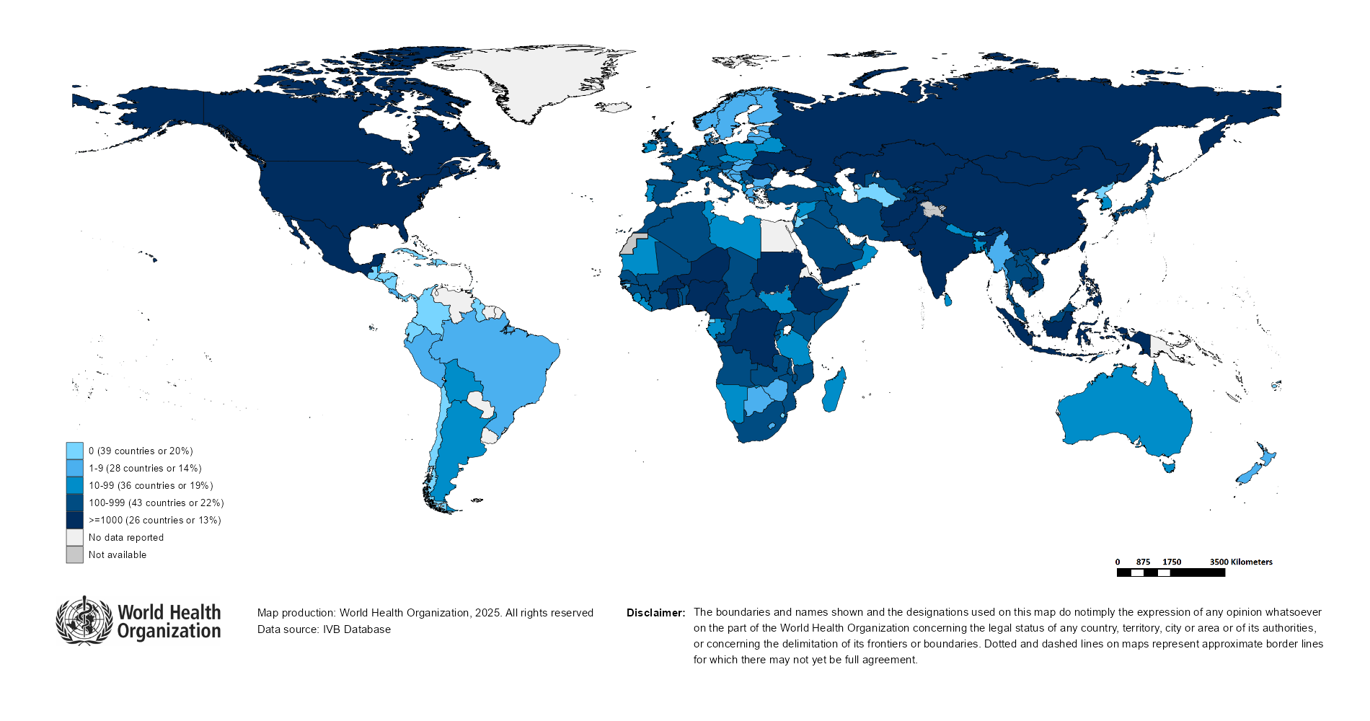
Number of Reported Measles Cases (Last 6 months)
Country | Cases*
Yemen | 20,622
Pakistan | 13,582
India** | 10,688
Kyrgyzstan | 8,125
Afghanistan | 7,143
Nigeria | 5,870
Ethiopia | 4,974
Russian Federation | 4,195
Romania | 4,058
Canada | 3,621
Notes: Based on data received 2025-08 - Surveillance data from 2025-01 to 2025-06 - * Countries with highest number of cases for the period - **WHO classifies all suspected measles cases reported from India as measles clinically compatible if a specimen was not collected as per the algorithm for classification of suspected measles in the WHO VPD Surveillance Standards. Thus numbers might be different between what WHO reports and what India reports.

Slide 13

Surveillance sensitivity reporting rate of measles and rubella (12 months, discarded cases* per 100,000 population)
Notes: Based on data received 2025-08 - Surveillance data from 2024-07 to 2025-06 - Target: >= 2 discarded cases* / 100,000 population** - * Suspected cases investigated and discarded as non-measles non-rubella using laboratory testing and/or epidemiological linkage to another etiology ** World population prospects, 2019 revision

Slide 14
Disclaimer
This document contains data provided to WHO by member states. Note that some member states only provide aggregate data to WHO, and for these, we are unable to generate a country profile. Some member states report all cases at one time point for the entire year, and thus epidemiologic curves generated are not accurate and a reporting artifact. For some countries, cases are reported by age category, not by exact age in months and/or years. Thus, age distribution/incidence is approximate. Cases classified as pending by countries are classified at WHO as clinically compatible at this time, and thus numbers might different between data shown here and provided by the member state or WHO country/regional offices.
*UN population data is used as the denominator for calculating incidence.

Slide 15
Measles case distribution (AFR), 2020-2025
2020
2021
2022
2023
2024
2025
20,000
46,747 cases
26,492 cases
64,922 cases
73,443 cases
86,127 cases
28,434 cases
15,000
10,000
5,000
0
Jan
Feb
Mar
Apr
May
Jun
Jul
Aug
Sep
Oct
Nov
Dec
Jan
Feb
Mar
Apr
May
Jun
Jul
Aug
Sep
Oct
Nov
Dec
Jan
Feb
Mar
Apr
May
Jun
Jul
Aug
Sep
Oct
Nov
Dec
Jan
Feb
Mar
Apr
May
Jun
Jul
Aug
Sep
Oct
Nov
Dec
Jan
Feb
Mar
Apr
May
Jun
Jul
Aug
Sep
Oct
Nov
Dec
Jan
Feb
Mar
Apr
May
Jun
Jul
Aug
Sep
Oct
Nov
Dec
Cameroon
DR Congo
Ethiopia
Liberia
Nigeria
Others
Based on data received 2025-08 - Data Source: IVB Database

Slide 16
Measles cases: Burundi
ELIMINATION STATUS:
ENDEMIC
2021
2022
2023
2024
2025
800
371 case(s)
222 case(s)
1,694 case(s)
2,616 case(s)
651 case(s)
SIA
600
Discarded
Clinical
Epi
Number of measles cases
Lab
400
200
0
Jan
Feb
Mar
Apr
May
Jun
Jul
Aug
Sep
Oct
Nov
Dec
Jan
Feb
Mar
Apr
May
Jun
Jul
Aug
Sep
Oct
Nov
Dec
Jan
Feb
Mar
Apr
May
Jun
Jul
Aug
Sep
Oct
Nov
Dec
Jan
Feb
Mar
Apr
May
Jun
Jul
Aug
Sep
Oct
Nov
Dec
Jan
Feb
Mar
Apr
May
Jun
Jul
Aug
Sep
Oct
Nov
Dec
Age distribution, vaccination status and incidence (last 12 months)
WHO/UNICEF Coverage Estimates (WUENIC)
300
100
600
80
200
400
60
Number of cases
Incidence rate per M
100
% Coverage
200
40
0
0
20
<1 yr
1-4 yrs
5-9 yrs
10-14 yrs
15-24 yrs
25-39 yrs
40+ yrs
0
Age at onset (in years)
2000
2001
2002
2003
2004
2005
2006
2007
2008
2009
2010
2011
2012
2013
2014
2015
2016
2017
2018
2019
2020
2021
2022
2023
2024
Incidence
2+ doses
1 dose
0 doses
Unknown
MCV1
MCV2
Based on data received 2025-08 - Data Source: IVB Database. Main epi curve was built using case-based surveillance data. Age distribution curve was built using case-based surveillance data. Coverage data from WHO/UNICEF Estimates of National Immunization Coverage (WUENIC)

Slide 17
Measles cases: Democratic Republic of the Congo
ELIMINATION STATUS:
ENDEMIC
2021
2022
2023
2024
2025
3,000
3,443 case(s)
4,365 case(s)
10,701 case(s)
5,086 case(s)
2,319 case(s)
SIA
Discarded
2,000
Clinical
Epi
Number of measles cases
Lab
1,000
0
Jan
Feb
Mar
Apr
May
Jun
Jul
Aug
Sep
Oct
Nov
Dec
Jan
Feb
Mar
Apr
May
Jun
Jul
Aug
Sep
Oct
Nov
Dec
Jan
Feb
Mar
Apr
May
Jun
Jul
Aug
Sep
Oct
Nov
Dec
Jan
Feb
Mar
Apr
May
Jun
Jul
Aug
Sep
Oct
Nov
Dec
Jan
Feb
Mar
Apr
May
Jun
Jul
Aug
Sep
Oct
Nov
Dec
Age distribution, vaccination status and incidence (last 12 months)
WHO/UNICEF Coverage Estimates (WUENIC)
100
1,500
100
80
Number of cases
1,000
Incidence rate per M
60
50
% Coverage
500
40
0
0
20
<1 yr
1-4 yrs
5-9 yrs
10-14 yrs
15-24 yrs
25-39 yrs
40+ yrs
0
Age at onset (in years)
2000
2001
2002
2003
2004
2005
2006
2007
2008
2009
2010
2011
2012
2013
2014
2015
2016
2017
2018
2019
2020
2021
2022
2023
2024
Incidence
2+ doses
1 dose
0 doses
Unknown
MCV1
MCV2
Based on data received 2025-08 - Data Source: IVB Database. Main epi curve was built using case-based surveillance data. Age distribution curve was built using case-based surveillance data. Coverage data from WHO/UNICEF Estimates of National Immunization Coverage (WUENIC)

Slide 18
Measles cases: Ethiopia
ELIMINATION STATUS:
ENDEMIC
2021
2022
2023
2024
2025
1,947 case(s)
8,216 case(s)
16,505 case(s)
30,201 case(s)
5,008 case(s)
SIA
8,000
Discarded
6,000
Clinical
Epi
Number of measles cases
Lab
4,000
2,000
0
Jan
Feb
Mar
Apr
May
Jun
Jul
Aug
Sep
Oct
Nov
Dec
Jan
Feb
Mar
Apr
May
Jun
Jul
Aug
Sep
Oct
Nov
Dec
Jan
Feb
Mar
Apr
May
Jun
Jul
Aug
Sep
Oct
Nov
Dec
Jan
Feb
Mar
Apr
May
Jun
Jul
Aug
Sep
Oct
Nov
Dec
Jan
Feb
Mar
Apr
May
Jun
Jul
Aug
Sep
Oct
Nov
Dec
Age distribution, vaccination status and incidence (last 12 months)
WHO/UNICEF Coverage Estimates (WUENIC)
4,000
300
100
3,000
200
80
Number of cases
2,000
Incidence rate per M
60
100
% Coverage
1,000
40
0
0
20
<1 yr
1-4 yrs
5-9 yrs
10-14 yrs
15-24 yrs
25-39 yrs
40+ yrs
0
Age at onset (in years)
2000
2001
2002
2003
2004
2005
2006
2007
2008
2009
2010
2011
2012
2013
2014
2015
2016
2017
2018
2019
2020
2021
2022
2023
2024
Incidence
2+ doses
1 dose
0 doses
Unknown
MCV1
MCV2
Based on data received 2025-08 - Data Source: IVB Database. Main epi curve was built using case-based surveillance data. Age distribution curve was built using case-based surveillance data. Coverage data from WHO/UNICEF Estimates of National Immunization Coverage (WUENIC)

Slide 19
Measles cases: Ghana
ELIMINATION STATUS:
ENDEMIC
2021
2022
2023
2024
2025
58 case(s)
242 case(s)
2,279 case(s)
4,189 case(s)
1,266 case(s)
SIA
1,000
Discarded
Clinical
Epi
Number of measles cases
Lab
500
0
Jan
Feb
Mar
Apr
May
Jun
Jul
Aug
Sep
Oct
Nov
Dec
Jan
Feb
Mar
Apr
May
Jun
Jul
Aug
Sep
Oct
Nov
Dec
Jan
Feb
Mar
Apr
May
Jun
Jul
Aug
Sep
Oct
Nov
Dec
Jan
Feb
Mar
Apr
May
Jun
Jul
Aug
Sep
Oct
Nov
Dec
Jan
Feb
Mar
Apr
May
Jun
Jul
Aug
Sep
Oct
Nov
Dec
Age distribution, vaccination status and incidence (last 12 months)
WHO/UNICEF Coverage Estimates (WUENIC)
500
250
100
400
200
80
300
150
60
Number of cases
Incidence rate per M
200
100
% Coverage
100
50
40
0
0
20
<1 yr
1-4 yrs
5-9 yrs
10-14 yrs
15-24 yrs
25-39 yrs
40+ yrs
0
Age at onset (in years)
2000
2001
2002
2003
2004
2005
2006
2007
2008
2009
2010
2011
2012
2013
2014
2015
2016
2017
2018
2019
2020
2021
2022
2023
2024
Incidence
2+ doses
1 dose
0 doses
Unknown
MCV1
MCV2
Based on data received 2025-08 - Data Source: IVB Database. Main epi curve was built using case-based surveillance data. Age distribution curve was built using case-based surveillance data. Coverage data from WHO/UNICEF Estimates of National Immunization Coverage (WUENIC)

Slide 20
Measles cases: Nigeria
ELIMINATION STATUS:
ENDEMIC
2021
2022
2023
2024
2025
10,871 case(s)
20,748 case(s)
12,224 case(s)
10,948 case(s)
5,896 case(s)
SIA
8,000
Discarded
6,000
Clinical
Epi
Number of measles cases
Lab
4,000
2,000
0
Jan
Feb
Mar
Apr
May
Jun
Jul
Aug
Sep
Oct
Nov
Dec
Jan
Feb
Mar
Apr
May
Jun
Jul
Aug
Sep
Oct
Nov
Dec
Jan
Feb
Mar
Apr
May
Jun
Jul
Aug
Sep
Oct
Nov
Dec
Jan
Feb
Mar
Apr
May
Jun
Jul
Aug
Sep
Oct
Nov
Dec
Jan
Feb
Mar
Apr
May
Jun
Jul
Aug
Sep
Oct
Nov
Dec
Age distribution, vaccination status and incidence (last 12 months)
WHO/UNICEF Coverage Estimates (WUENIC)
3,000
100
100
80
2,000
Incidence rate per M
60
Number of cases
% Coverage
1,000
50
40
0
0
20
<1 yr
1-4 yrs
5-9 yrs
10-14 yrs
15-24 yrs
25-39 yrs
40+ yrs
0
Age at onset (in years)
2000
2001
2002
2003
2004
2005
2006
2007
2008
2009
2010
2011
2012
2013
2014
2015
2016
2017
2018
2019
2020
2021
2022
2023
2024
Incidence
2+ doses
1 dose
0 doses
Unknown
MCV1
MCV2
Based on data received 2025-08 - Data Source: IVB Database. Main epi curve was built using case-based surveillance data. Age distribution curve was built using case-based surveillance data. Coverage data from WHO/UNICEF Estimates of National Immunization Coverage (WUENIC)

Slide 21
Measles cases: Sudan
ELIMINATION STATUS:
ENDEMIC
2021
2022
2023
2024
2025
2,000
779 case(s)
2,029 case(s)
4,429 case(s)
1,452 case(s)
2,702 case(s)
SIA
1,500
Discarded
Clinical
Epi
Number of measles cases
Lab
1,000
500
0
Jan
Feb
Mar
Apr
May
Jun
Jul
Aug
Sep
Oct
Nov
Dec
Jan
Feb
Mar
Apr
May
Jun
Jul
Aug
Sep
Oct
Nov
Dec
Jan
Feb
Mar
Apr
May
Jun
Jul
Aug
Sep
Oct
Nov
Dec
Jan
Feb
Mar
Apr
May
Jun
Jul
Aug
Sep
Oct
Nov
Dec
Jan
Feb
Mar
Apr
May
Jun
Jul
Aug
Sep
Oct
Nov
Dec
Age distribution, vaccination status and incidence (last 12 months)
WHO/UNICEF Coverage Estimates (WUENIC)
1,500
100
300
80
1,000
200
Number of cases
Incidence rate per M
60
500
% Coverage
100
40
0
0
20
<1 yr
1-4 yrs
5-9 yrs
10-14 yrs
15-24 yrs
25-39 yrs
40+ yrs
0
Age at onset (in years)
2000
2001
2002
2003
2004
2005
2006
2007
2008
2009
2010
2011
2012
2013
2014
2015
2016
2017
2018
2019
2020
2021
2022
2023
2024
Incidence
2+ doses
1 dose
0 doses
Unknown
MCV1
MCV2
Based on data received 2025-08 - Data Source: IVB Database. Main epi curve was built using case-based surveillance data. Age distribution curve was built using case-based surveillance data. Coverage data from WHO/UNICEF Estimates of National Immunization Coverage (WUENIC)

Slide 22
Measles case distribution (AMR), 2020-2025
2020
2021
2022
2023
2024
2025
8,708 cases
712 cases
169 cases
73 cases
463 cases
9,045 cases
3,000
2,000
1,000
0
Jan
Feb
Mar
Apr
May
Jun
Jul
Aug
Sep
Oct
Nov
Dec
Jan
Feb
Mar
Apr
May
Jun
Jul
Aug
Sep
Oct
Nov
Dec
Jan
Feb
Mar
Apr
May
Jun
Jul
Aug
Sep
Oct
Nov
Dec
Jan
Feb
Mar
Apr
May
Jun
Jul
Aug
Sep
Oct
Nov
Dec
Jan
Feb
Mar
Apr
May
Jun
Jul
Aug
Sep
Oct
Nov
Dec
Jan
Feb
Mar
Apr
May
Jun
Jul
Aug
Sep
Oct
Nov
Dec
Argentina
Brazil
Canada
Mexico
Others
USA
Based on data received 2025-08 - Data Source: IVB Database

Slide 23
Measles cases: Canada
ELIMINATION STATUS:
VERIFIED
2022
2023
2024
2025
3 case(s)
12 case(s)
148 case(s)
4,067 case(s)
Discarded
Clinical
1,000
Epi
Lab
Number of measles cases
500
0
Jan
Feb
Mar
Apr
May
Jun
Jul
Aug
Sep
Oct
Nov
Dec
Jan
Feb
Mar
Apr
May
Jun
Jul
Aug
Sep
Oct
Nov
Dec
Jan
Feb
Mar
Apr
May
Jun
Jul
Aug
Sep
Oct
Nov
Dec
Jan
Feb
Mar
Apr
May
Jun
Jul
Aug
Sep
Oct
Nov
Dec
Age distribution, vaccination status and incidence (last 12 months)
WHO/UNICEF Coverage Estimates (WUENIC)
600
100
750
80
500
400
60
Number of cases
Incidence rate per M
200
% Coverage
250
40
0
0
20
<1 yr
1-4 yrs
5-9 yrs
10-14 yrs
15-24 yrs
25-39 yrs
40+ yrs
0
Age at onset (in years)
2000
2001
2002
2003
2004
2005
2006
2007
2008
2009
2010
2011
2012
2013
2014
2015
2016
2017
2018
2019
2020
2021
2022
2023
2024
Incidence
Unknown
MCV1
MCV2
Based on data received 2025-08 - Data Source: IVB Database. Main epi curve was built using case-based surveillance data. Age distribution curve was built using case-based surveillance data. Coverage data from WHO/UNICEF Estimates of National Immunization Coverage (WUENIC)

Slide 24
Measles cases: Mexico
ELIMINATION STATUS:
VERIFIED
2021
2022
2023
2024
2025
2,500
0 case(s)
0 case(s)
0 case(s)
7 case(s)
3,620 case(s)
Discarded
Clinical
2,000
Epi
Lab
1,500
Number of measles cases
1,000
500
0
Jan
Feb
Mar
Apr
May
Jun
Jul
Aug
Sep
Oct
Nov
Dec
Jan
Feb
Mar
Apr
May
Jun
Jul
Aug
Sep
Oct
Nov
Dec
Jan
Feb
Mar
Apr
May
Jun
Jul
Aug
Sep
Oct
Nov
Dec
Jan
Feb
Mar
Apr
May
Jun
Jul
Aug
Sep
Oct
Nov
Dec
Jan
Feb
Mar
Apr
May
Jun
Jul
Aug
Sep
Oct
Nov
Dec
Age distribution, vaccination status and incidence (last 12 months)
WHO/UNICEF Coverage Estimates (WUENIC)
150
100
900
80
100
600
Incidence rate per M
60
Number of cases
% Coverage
300
50
40
0
0
20
<1 yr
1-4 yrs
5-9 yrs
10-14 yrs
15-24 yrs
25-39 yrs
40+ yrs
0
Age at onset (in years)
2000
2001
2002
2003
2004
2005
2006
2007
2008
2009
2010
2011
2012
2013
2014
2015
2016
2017
2018
2019
2020
2021
2022
2023
2024
Incidence
2+ doses
1 dose
Unknown
MCV1
MCV2
Based on data received 2025-08 - Data Source: IVB Database. Main epi curve was built using case-based surveillance data. Age distribution curve was built using case-based surveillance data. Coverage data from WHO/UNICEF Estimates of National Immunization Coverage (WUENIC)

Slide 25
Measles case distribution (EMR), 2020-2025
2020
2021
2022
2023
2024
2025
9,829 cases
24,329 cases
57,465 cases
90,855 cases
96,713 cases
49,605 cases
16,000
12,000
8,000
4,000
0
Jan
Feb
Mar
Apr
May
Jun
Jul
Aug
Sep
Oct
Nov
Dec
Jan
Feb
Mar
Apr
May
Jun
Jul
Aug
Sep
Oct
Nov
Dec
Jan
Feb
Mar
Apr
May
Jun
Jul
Aug
Sep
Oct
Nov
Dec
Jan
Feb
Mar
Apr
May
Jun
Jul
Aug
Sep
Oct
Nov
Dec
Jan
Feb
Mar
Apr
May
Jun
Jul
Aug
Sep
Oct
Nov
Dec
Jan
Feb
Mar
Apr
May
Jun
Jul
Aug
Sep
Oct
Nov
Dec
Afghanistan
Iraq
Others
Pakistan
Somalia
Yemen
Based on data received 2025-08 - Data Source: IVB Database

Slide 26
Measles cases: Afghanistan
ELIMINATION STATUS:
ENDEMIC
2021
2022
2023
2024
2025
3,028 case(s)
5,119 case(s)
2,529 case(s)
9,769 case(s)
7,840 case(s)
SIA
2,000
Discarded
Clinical
Epi
Number of measles cases
Lab
1,000
0
Jan
Feb
Mar
Apr
May
Jun
Jul
Aug
Sep
Oct
Nov
Dec
Jan
Feb
Mar
Apr
May
Jun
Jul
Aug
Sep
Oct
Nov
Dec
Jan
Feb
Mar
Apr
May
Jun
Jul
Aug
Sep
Oct
Nov
Dec
Jan
Feb
Mar
Apr
May
Jun
Jul
Aug
Sep
Oct
Nov
Dec
Jan
Feb
Mar
Apr
May
Jun
Jul
Aug
Sep
Oct
Nov
Dec
Age distribution, vaccination status and incidence (last 12 months)
WHO/UNICEF Coverage Estimates (WUENIC)
100
4,000
2000
80
1500
Number of cases
Incidence rate per M
60
2,000
1000
% Coverage
500
40
0
0
20
<1 yr
1-4 yrs
5-9 yrs
10-14 yrs
15-24 yrs
25-39 yrs
40+ yrs
0
Age at onset (in years)
2000
2001
2002
2003
2004
2005
2006
2007
2008
2009
2010
2011
2012
2013
2014
2015
2016
2017
2018
2019
2020
2021
2022
2023
2024
Incidence
2+ doses
1 dose
0 doses
Unknown
MCV1
MCV2
Based on data received 2025-08 - Data Source: IVB Database. Main epi curve was built using case-based surveillance data. Age distribution curve was built using case-based surveillance data. Coverage data from WHO/UNICEF Estimates of National Immunization Coverage (WUENIC)

Slide 27
Measles cases: Pakistan
ELIMINATION STATUS:
ENDEMIC
2021
2022
2023
2024
2025
9,313 case(s)
7,917 case(s)
17,515 case(s)
24,263 case(s)
14,390 case(s)
SIA
10,000
Discarded
Clinical
Epi
Number of measles cases
Lab
5,000
0
Jan
Feb
Mar
Apr
May
Jun
Jul
Aug
Sep
Oct
Nov
Dec
Jan
Feb
Mar
Apr
May
Jun
Jul
Aug
Sep
Oct
Nov
Dec
Jan
Feb
Mar
Apr
May
Jun
Jul
Aug
Sep
Oct
Nov
Dec
Jan
Feb
Mar
Apr
May
Jun
Jul
Aug
Sep
Oct
Nov
Dec
Jan
Feb
Mar
Apr
May
Jun
Jul
Aug
Sep
Oct
Nov
Dec
Age distribution, vaccination status and incidence (last 12 months)
WHO/UNICEF Coverage Estimates (WUENIC)
10,000
1000
100
7,500
750
80
Number of cases
5,000
Incidence rate per M
60
500
% Coverage
2,500
250
40
0
0
20
<1 yr
1-4 yrs
5-9 yrs
10-14 yrs
15-24 yrs
25-39 yrs
40+ yrs
0
Age at onset (in years)
2000
2001
2002
2003
2004
2005
2006
2007
2008
2009
2010
2011
2012
2013
2014
2015
2016
2017
2018
2019
2020
2021
2022
2023
2024
Incidence
2+ doses
1 dose
0 doses
Unknown
MCV1
MCV2
Based on data received 2025-08 - Data Source: IVB Database. Main epi curve was built using case-based surveillance data. Age distribution curve was built using case-based surveillance data. Coverage data from WHO/UNICEF Estimates of National Immunization Coverage (WUENIC)

Slide 28
Measles cases: Yemen
ELIMINATION STATUS:
ENDEMIC
2021
2022
2023
2024
2025
4,825 case(s)
23,924 case(s)
49,571 case(s)
23,990 case(s)
22,062 case(s)
SIA
6,000
Discarded
Clinical
Epi
4,000
Number of measles cases
Lab
2,000
0
Jan
Feb
Mar
Apr
May
Jun
Jul
Aug
Sep
Oct
Nov
Dec
Jan
Feb
Mar
Apr
May
Jun
Jul
Aug
Sep
Oct
Nov
Dec
Jan
Feb
Mar
Apr
May
Jun
Jul
Aug
Sep
Oct
Nov
Dec
Jan
Feb
Mar
Apr
May
Jun
Jul
Aug
Sep
Oct
Nov
Dec
Jan
Feb
Mar
Apr
May
Jun
Jul
Aug
Sep
Oct
Nov
Dec
Age distribution, vaccination status and incidence (last 12 months)
WHO/UNICEF Coverage Estimates (WUENIC)
15,000
4000
100
10,000
3000
80
Number of cases
Incidence rate per M
60
2000
% Coverage
5,000
1000
40
0
0
20
<1 yr
1-4 yrs
5-9 yrs
10-14 yrs
15-24 yrs
25-39 yrs
40+ yrs
0
Age at onset (in years)
2000
2001
2002
2003
2004
2005
2006
2007
2008
2009
2010
2011
2012
2013
2014
2015
2016
2017
2018
2019
2020
2021
2022
2023
2024
Incidence
2+ doses
1 dose
0 doses
Unknown
MCV1
MCV2
Based on data received 2025-08 - Data Source: IVB Database. Main epi curve was built using case-based surveillance data. Age distribution curve was built using case-based surveillance data. Coverage data from WHO/UNICEF Estimates of National Immunization Coverage (WUENIC)

Slide 29
Measles case distribution (EUR), 2020-2025
2020
2021
2022
2023
2024
2025
30,000
12,193 cases
150 cases
901 cases
60,931 cases
127,325 cases
27,266 cases
20,000
10,000
0
Jan
Feb
Mar
Apr
May
Jun
Jul
Aug
Sep
Oct
Nov
Dec
Jan
Feb
Mar
Apr
May
Jun
Jul
Aug
Sep
Oct
Nov
Dec
Jan
Feb
Mar
Apr
May
Jun
Jul
Aug
Sep
Oct
Nov
Dec
Jan
Feb
Mar
Apr
May
Jun
Jul
Aug
Sep
Oct
Nov
Dec
Jan
Feb
Mar
Apr
May
Jun
Jul
Aug
Sep
Oct
Nov
Dec
Jan
Feb
Mar
Apr
May
Jun
Jul
Aug
Sep
Oct
Nov
Dec
Azerbaijan
Kazakhstan
Kyrgyzstan
Others
Romania
Russian Federation
Based on data received 2025-08 - Data Source: IVB Database

Slide 30
Measles cases: Israel
ELIMINATION STATUS:
ELIMINATED
2021
2023
2024
2025
0 case(s)
18 case(s)
26 case(s)
145 case(s)
Discarded
Clinical
60
Epi
Lab
40
Number of measles cases
20
0
Jan
Feb
Mar
Apr
May
Jun
Jul
Aug
Sep
Oct
Nov
Dec
Jan
Feb
Mar
Apr
May
Jun
Jul
Aug
Sep
Oct
Nov
Dec
Jan
Feb
Mar
Apr
May
Jun
Jul
Aug
Sep
Oct
Nov
Dec
Jan
Feb
Mar
Apr
May
Jun
Jul
Aug
Sep
Oct
Nov
Dec
Age distribution, vaccination status and incidence (last 12 months)
WHO/UNICEF Coverage Estimates (WUENIC)
50
125
100
40
100
80
30
75
60
Number of cases
Incidence rate per M
20
50
% Coverage
10
25
40
0
0
20
<1 yr
1-4 yrs
5-9 yrs
10-14 yrs
15-24 yrs
25-39 yrs
40+ yrs
0
Age at onset (in years)
2000
2001
2002
2003
2004
2005
2006
2007
2008
2009
2010
2011
2012
2013
2014
2015
2016
2017
2018
2019
2020
2021
2022
2023
2024
Incidence
2+ doses
1 dose
0 doses
Unknown
MCV1
MCV2
Based on data received 2025-08 - Data Source: IVB Database. Main epi curve was built using case-based surveillance data. Age distribution curve was built using case-based surveillance data. Coverage data from WHO/UNICEF Estimates of National Immunization Coverage (WUENIC)

Slide 31
Measles cases: Kyrgyzstan
ELIMINATION STATUS:
ENDEMIC
2021
2022
2023
2024
2025
4 case(s)
23 case(s)
7,463 case(s)
14,408 case(s)
8,125 case(s)
SIA
3,000
Discarded
Clinical
2,000
Epi
Number of measles cases
Lab
1,000
0
Jan
Feb
Mar
Apr
May
Jun
Jul
Aug
Sep
Oct
Nov
Dec
Jan
Feb
Mar
Apr
May
Jun
Jul
Aug
Sep
Oct
Nov
Dec
Jan
Feb
Mar
Apr
May
Jun
Jul
Aug
Sep
Oct
Nov
Dec
Jan
Feb
Mar
Apr
May
Jun
Jul
Aug
Sep
Oct
Nov
Dec
Jan
Feb
Mar
Apr
May
Jun
Jul
Aug
Sep
Oct
Nov
Dec
Age distribution, vaccination status and incidence (last 12 months)
WHO/UNICEF Coverage Estimates (WUENIC)
4,000
100
3,000
20000
80
15000
Number of cases
2,000
Incidence rate per M
60
10000
% Coverage
1,000
5000
40
0
0
20
<1 yr
1-4 yrs
5-9 yrs
10-14 yrs
15-24 yrs
25-39 yrs
40+ yrs
0
Age at onset (in years)
2000
2001
2002
2003
2004
2005
2006
2007
2008
2009
2010
2011
2012
2013
2014
2015
2016
2017
2018
2019
2020
2021
2022
2023
2024
Incidence
2+ doses
1 dose
0 doses
Unknown
MCV1
MCV2
Based on data received 2025-08 - Data Source: IVB Database. Main epi curve was built using case-based surveillance data. Age distribution curve was built using case-based surveillance data. Coverage data from WHO/UNICEF Estimates of National Immunization Coverage (WUENIC)

Slide 32
Measles cases: Russian Federation
ELIMINATION STATUS:
RE-ESTABLISHED
2021
2022
2023
2024
2025
1 case(s)
117 case(s)
12,960 case(s)
22,076 case(s)
4,268 case(s)
SIA
6,000
Discarded
Clinical
4,000
Epi
Number of measles cases
Lab
2,000
0
Jan
Feb
Mar
Apr
May
Jun
Jul
Aug
Sep
Oct
Nov
Dec
Jan
Feb
Mar
Apr
May
Jun
Jul
Aug
Sep
Oct
Nov
Dec
Jan
Feb
Mar
Apr
May
Jun
Jul
Aug
Sep
Oct
Nov
Dec
Jan
Feb
Mar
Apr
May
Jun
Jul
Aug
Sep
Oct
Nov
Dec
Jan
Feb
Mar
Apr
May
Jun
Jul
Aug
Sep
Oct
Nov
Dec
Age distribution, vaccination status and incidence (last 12 months)
WHO/UNICEF Coverage Estimates (WUENIC)
100
1,000
400
80
Number of cases
Incidence rate per M
60
500
200
% Coverage
40
0
0
20
<1 yr
1-4 yrs
5-9 yrs
10-14 yrs
15-24 yrs
25-39 yrs
40+ yrs
0
Age at onset (in years)
2000
2001
2002
2003
2004
2005
2006
2007
2008
2009
2010
2011
2012
2013
2014
2015
2016
2017
2018
2019
2020
2021
2022
2023
2024
Incidence
2+ doses
1 dose
0 doses
Unknown
MCV1
MCV2
Based on data received 2025-08 - Data Source: IVB Database. Main epi curve was built using case-based surveillance data. Age distribution curve was built using case-based surveillance data. Coverage data from WHO/UNICEF Estimates of National Immunization Coverage (WUENIC)

Slide 33
Measles cases: Tajikistan
ELIMINATION STATUS:
RE-ESTABLISHED
2021
2022
2023
2024
2025
1,500
10 case(s)
451 case(s)
294 case(s)
0 case(s)
2,196 case(s)
SIA
Discarded
1,000
Clinical
Epi
Number of measles cases
Lab
500
0
Jan
Feb
Mar
Apr
May
Jun
Jul
Aug
Sep
Oct
Nov
Dec
Jan
Feb
Mar
Apr
May
Jun
Jul
Aug
Sep
Oct
Nov
Dec
Jan
Feb
Mar
Apr
May
Jun
Jul
Aug
Sep
Oct
Nov
Dec
Jan
Feb
Mar
Apr
May
Jun
Jul
Aug
Sep
Oct
Nov
Dec
Jan
Feb
Mar
Apr
May
Jun
Jul
Aug
Sep
Oct
Nov
Dec
Age distribution, vaccination status and incidence (last 12 months)
WHO/UNICEF Coverage Estimates (WUENIC)
1,500
1500
100
80
1,000
1000
Number of cases
Incidence rate per M
60
500
500
% Coverage
40
0
0
20
<1 yr
1-4 yrs
5-9 yrs
10-14 yrs
15-24 yrs
25-39 yrs
40+ yrs
0
Age at onset (in years)
2000
2001
2002
2003
2004
2005
2006
2007
2008
2009
2010
2011
2012
2013
2014
2015
2016
2017
2018
2019
2020
2021
2022
2023
2024
Incidence
1 dose
0 doses
Unknown
MCV1
MCV2
Based on data received 2025-08 - Data Source: IVB Database. Main epi curve was built using case-based surveillance data. Age distribution curve was built using case-based surveillance data. Coverage data from WHO/UNICEF Estimates of National Immunization Coverage (WUENIC)

Slide 34
Measles case distribution (SEAR (excl. India)), 2020-2025
2020
2021
2022
2023
2024
2025
2,000
4,059 cases
425 cases
552 cases
2,159 cases
8,899 cases
900 cases
1,500
1,000
500
0
Jan
Feb
Mar
Apr
May
Jun
Jul
Aug
Sep
Oct
Nov
Dec
Jan
Feb
Mar
Apr
May
Jun
Jul
Aug
Sep
Oct
Nov
Dec
Jan
Feb
Mar
Apr
May
Jun
Jul
Aug
Sep
Oct
Nov
Dec
Jan
Feb
Mar
Apr
May
Jun
Jul
Aug
Sep
Oct
Nov
Dec
Jan
Feb
Mar
Apr
May
Jun
Jul
Aug
Sep
Oct
Nov
Dec
Jan
Feb
Mar
Apr
May
Jun
Jul
Aug
Sep
Oct
Nov
Dec
Bangladesh
Myanmar
Nepal
Others
Sri Lanka
Thailand
Based on data received 2025-08 - Data Source: IVB Database

Slide 35
Measles case distribution (SEAR, India), 2020-2025
2020
2021
2022
2023
2024
2025
16,000
5,598 cases
6,025 cases
43,578 cases
68,794 cases
20,763 cases
11,957 cases
12,000
8,000
4,000
0
Jan
Feb
Mar
Apr
May
Jun
Jul
Aug
Sep
Oct
Nov
Dec
Jan
Feb
Mar
Apr
May
Jun
Jul
Aug
Sep
Oct
Nov
Dec
Jan
Feb
Mar
Apr
May
Jun
Jul
Aug
Sep
Oct
Nov
Dec
Jan
Feb
Mar
Apr
May
Jun
Jul
Aug
Sep
Oct
Nov
Dec
Jan
Feb
Mar
Apr
May
Jun
Jul
Aug
Sep
Oct
Nov
Dec
Jan
Feb
Mar
Apr
May
Jun
Jul
Aug
Sep
Oct
Nov
Dec
India
Based on data received 2025-08 - Data Source: IVB Database

Slide 36
Measles cases: India
ELIMINATION STATUS:
ENDEMIC
2021
2022
2023
2024
2025
30,000
6,025 case(s)
43,578 case(s)
68,794 case(s)
20,763 case(s)
11,957 case(s)
SIA
Discarded
20,000
Clinical
Epi
Number of measles cases
Lab
10,000
0
Jan
Feb
Mar
Apr
May
Jun
Jul
Aug
Sep
Oct
Nov
Dec
Jan
Feb
Mar
Apr
May
Jun
Jul
Aug
Sep
Oct
Nov
Dec
Jan
Feb
Mar
Apr
May
Jun
Jul
Aug
Sep
Oct
Nov
Dec
Jan
Feb
Mar
Apr
May
Jun
Jul
Aug
Sep
Oct
Nov
Dec
Jan
Feb
Mar
Apr
May
Jun
Jul
Aug
Sep
Oct
Nov
Dec
Age distribution, vaccination status and incidence (last 12 months)
WHO/UNICEF Coverage Estimates (WUENIC)
6,000
150
100
4,000
100
80
Number of cases
Incidence rate per M
60
2,000
50
% Coverage
40
0
0
20
<1 yr
1-4 yrs
5-9 yrs
10-14 yrs
15-24 yrs
25-39 yrs
40+ yrs
0
Age at onset (in years)
2000
2001
2002
2003
2004
2005
2006
2007
2008
2009
2010
2011
2012
2013
2014
2015
2016
2017
2018
2019
2020
2021
2022
2023
2024
Incidence
2+ doses
1 dose
Unknown
MCV1
MCV2
Based on data received 2025-08 - Data Source: IVB Database. Main epi curve was built using case-based surveillance data. Age distribution curve was built using case-based surveillance data. Coverage data from WHO/UNICEF Estimates of National Immunization Coverage (WUENIC)

Slide 37
Measles case distribution (WPR), 2020-2025
2020
2021
2022
2023
2024
2025
6,706 cases
1,486 cases
6,753 cases
25,621 cases
19,202 cases
9,892 cases
3,000
2,000
1,000
0
Jan
Feb
Mar
Apr
May
Jun
Jul
Aug
Sep
Oct
Nov
Dec
Jan
Feb
Mar
Apr
May
Jun
Jul
Aug
Sep
Oct
Nov
Dec
Jan
Feb
Mar
Apr
May
Jun
Jul
Aug
Sep
Oct
Nov
Dec
Jan
Feb
Mar
Apr
May
Jun
Jul
Aug
Sep
Oct
Nov
Dec
Jan
Feb
Mar
Apr
May
Jun
Jul
Aug
Sep
Oct
Nov
Dec
Jan
Feb
Mar
Apr
May
Jun
Jul
Aug
Sep
Oct
Nov
Dec
China
Indonesia
Malaysia
Others
Philippines
Viet Nam
Based on data received 2025-08 - Data Source: IVB Database

Slide 38
Measles cases: Indonesia
ELIMINATION STATUS:
ENDEMIC
2021
2022
2023
2024
2025
8,000
290 case(s)
5,362 case(s)
19,879 case(s)
7,191 case(s)
2,482 case(s)
Discarded
Clinical
6,000
Epi
Lab
Number of measles cases
4,000
2,000
0
Jan
Feb
Mar
Apr
May
Jun
Jul
Aug
Sep
Oct
Nov
Dec
Jan
Feb
Mar
Apr
May
Jun
Jul
Aug
Sep
Oct
Nov
Dec
Jan
Feb
Mar
Apr
May
Jun
Jul
Aug
Sep
Oct
Nov
Dec
Jan
Feb
Mar
Apr
May
Jun
Jul
Aug
Sep
Oct
Nov
Dec
Jan
Feb
Mar
Apr
May
Jun
Jul
Aug
Sep
Oct
Nov
Dec
Age distribution, vaccination status and incidence (last 12 months)
WHO/UNICEF Coverage Estimates (WUENIC)
80
100
1,000
60
80
40
60
Number of cases
Incidence rate per M
500
% Coverage
20
40
0
0
20
<1 yr
1-4 yrs
5-9 yrs
10-14 yrs
15-24 yrs
25-39 yrs
40+ yrs
0
Age at onset (in years)
2000
2001
2002
2003
2004
2005
2006
2007
2008
2009
2010
2011
2012
2013
2014
2015
2016
2017
2018
2019
2020
2021
2022
2023
2024
Incidence
2+ doses
1 dose
0 doses
Unknown
MCV1
MCV2
Based on data received 2025-08 - Data Source: IVB Database. Main epi curve was built using a combination of case-based and aggregate surveillance data. Age distribution curve was built using case-based surveillance data. Coverage data from WHO/UNICEF Estimates of National Immunization Coverage (WUENIC)

Slide 39
Measles cases: Mongolia
ELIMINATION STATUS:
ELIMINATED
2021
2022
2023
2024
2025
0 case(s)
0 case(s)
0 case(s)
12 case(s)
1,187 case(s)
SIA
600
Discarded
Clinical
Epi
400
Number of measles cases
Lab
200
0
Jan
Feb
Mar
Apr
May
Jun
Jul
Aug
Sep
Oct
Nov
Dec
Jan
Feb
Mar
Apr
May
Jun
Jul
Aug
Sep
Oct
Nov
Dec
Jan
Feb
Mar
Apr
May
Jun
Jul
Aug
Sep
Oct
Nov
Dec
Jan
Feb
Mar
Apr
May
Jun
Jul
Aug
Sep
Oct
Nov
Dec
Jan
Feb
Mar
Apr
May
Jun
Jul
Aug
Sep
Oct
Nov
Dec
Age distribution, vaccination status and incidence (last 12 months)
WHO/UNICEF Coverage Estimates (WUENIC)
2000
100
400
1500
80
Number of cases
Incidence rate per M
60
200
1000
% Coverage
500
40
0
0
20
<1 yr
1-4 yrs
5-9 yrs
10-14 yrs
15-24 yrs
25-39 yrs
40+ yrs
0
Age at onset (in years)
2000
2001
2002
2003
2004
2005
2006
2007
2008
2009
2010
2011
2012
2013
2014
2015
2016
2017
2018
2019
2020
2021
2022
2023
2024
Incidence
2+ doses
1 dose
0 doses
Unknown
MCV1
MCV2
Based on data received 2025-08 - Data Source: IVB Database. Main epi curve was built using case-based surveillance data. Age distribution curve was built using case-based surveillance data. Coverage data from WHO/UNICEF Estimates of National Immunization Coverage (WUENIC)

Slide 40
Measles cases: Philippines
ELIMINATION STATUS:
ENDEMIC
2021
2022
2023
2024
2025
218 case(s)
586 case(s)
2,880 case(s)
4,003 case(s)
2,259 case(s)
SIA
1,000
Discarded
Clinical
Epi
Number of measles cases
Lab
500
0
Jan
Feb
Mar
Apr
May
Jun
Jul
Aug
Sep
Oct
Nov
Dec
Jan
Feb
Mar
Apr
May
Jun
Jul
Aug
Sep
Oct
Nov
Dec
Jan
Feb
Mar
Apr
May
Jun
Jul
Aug
Sep
Oct
Nov
Dec
Jan
Feb
Mar
Apr
May
Jun
Jul
Aug
Sep
Oct
Nov
Dec
Jan
Feb
Mar
Apr
May
Jun
Jul
Aug
Sep
Oct
Nov
Dec
1,250
Age distribution, vaccination status and incidence (last 12 months)
WHO/UNICEF Coverage Estimates (WUENIC)
600
100
1,000
80
750
400
Number of cases
500
Incidence rate per M
60
200
% Coverage
250
40
0
0
20
<1 yr
1-4 yrs
5-9 yrs
10-14 yrs
15-24 yrs
25-39 yrs
40+ yrs
0
Age at onset (in years)
2000
2001
2002
2003
2004
2005
2006
2007
2008
2009
2010
2011
2012
2013
2014
2015
2016
2017
2018
2019
2020
2021
2022
2023
2024
Incidence
2+ doses
1 dose
0 doses
Unknown
MCV1
MCV2
Based on data received 2025-08 - Data Source: IVB Database. Main epi curve was built using case-based surveillance data. Age distribution curve was built using case-based surveillance data. Coverage data from WHO/UNICEF Estimates of National Immunization Coverage (WUENIC)

Slide 41
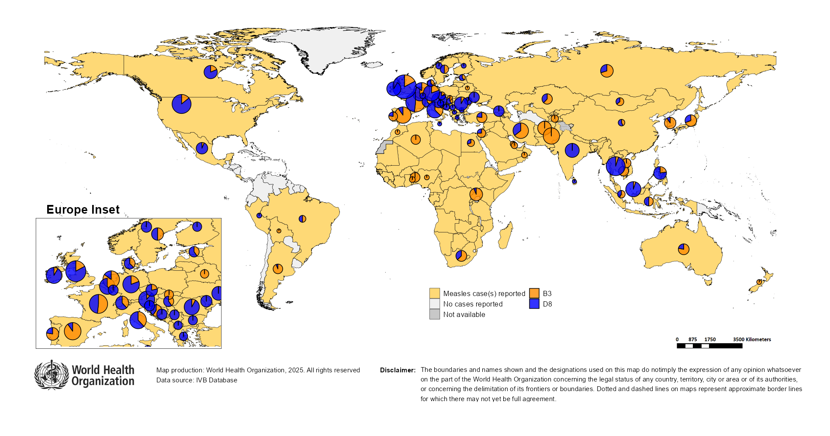
Distribution of measles genotypes (last 12 months)
Data Source: MeaNS2 database (Genotypes) and IVB Database (Incidence) as of 2025-08-18 and covering the period between 2024-07 and 2025-06 - Pie charts proportional to the number of sequenced viruses

Slide 42
Rubella

Slide 43
Number of reported rubella cases by WHO Region
2025
Region | Member States* | Rubella cases | Clin | Epi | Lab | Date Received
AFR | 41/47 | 2,076 | 0 | 0 | 2,076 | 2025-08
AMR | 25/35 | 0 | 0 | 0 | 0 | 2025-08
EMR | 20/21 | 1,366 | 1,029 | 4 | 333 | 2025-08
EUR | 28/53 | 374 | 16 | 8 | 350 | 2025-08
SEAR | 10/10 | 1,555 | 0 | 43 | 1,512 | 2025-08
WPR | 14/28 | 512 | 37 | 0 | 475 | 2025-08
Total | 138/194 | 5,883 | 1,082 | 55 | 4,746
Region | Jan | Feb | Mar | Apr | May | Jun | Jul | Aug | Sep | Oct | Nov | Dec
AFR | 374 | 387 | 416 | 357 | 255 | 189 | 98 | 0 | 0 | 0 | 0 | 0
AMR | 0 | 0 | 0 | 0 | 0 | 0 | 0 | 0 | 0 | 0 | 0 | 0
EMR | 236 | 384 | 309 | 283 | 76 | 55 | 23 | 0 | 0 | 0 | 0 | 0
EUR | 111 | 79 | 72 | 61 | 32 | 19 | 0 | 0 | 0 | 0 | 0 | 0
SEAR | 255 | 263 | 244 | 265 | 253 | 222 | 53 | 0 | 0 | 0 | 0 | 0
WPR | 126 | 123 | 106 | 81 | 44 | 32 | 0 | 0 | 0 | 0 | 0 | 0
Total | 1,102 | 1,236 | 1,147 | 1,047 | 660 | 517 | 174 | 0 | 0 | 0 | 0 | 0
2024
Region | Member States* | Rubella cases | Clin | Epi | Lab | Date Received
AFR | 43/47 | 15,738 | 0 | 0 | 15,738 | 2025-08
AMR | 28/35 | 0 | 0 | 0 | 0 | 2025-08
EMR | 21/21 | 3,521 | 2,516 | 188 | 817 | 2025-08
EUR | 33/53 | 511 | 213 | 2 | 296 | 2025-08
SEAR | 10/10 | 2,677 | 0 | 106 | 2,571 | 2025-08
WPR | 17/28 | 1,118 | 81 | 0 | 1,037 | 2025-08
Total | 152/194 | 23,565 | 2,810 | 296 | 20,459
Region | Jan | Feb | Mar | Apr | May | Jun | Jul | Aug | Sep | Oct | Nov | Dec
AFR | 357 | 345 | 645 | 567 | 832 | 574 | 396 | 1,897 | 4,278 | 3,063 | 1,880 | 904
AMR | 0 | 0 | 0 | 0 | 0 | 0 | 0 | 0 | 0 | 0 | 0 | 0
EMR | 339 | 363 | 367 | 288 | 353 | 287 | 235 | 268 | 385 | 361 | 196 | 79
EUR | 25 | 39 | 50 | 67 | 78 | 52 | 43 | 50 | 31 | 25 | 28 | 23
SEAR | 245 | 265 | 262 | 238 | 209 | 168 | 232 | 181 | 191 | 237 | 240 | 209
WPR | 75 | 78 | 130 | 95 | 116 | 93 | 59 | 97 | 99 | 125 | 82 | 69
Total | 1,041 | 1,090 | 1,454 | 1,255 | 1,588 | 1,174 | 965 | 2,493 | 4,984 | 3,811 | 2,426 | 1,284
Notes: Based on data received 2025-08 - This is surveillance data, hence for the last month, the data may be incomplete. * Member States Reporting / Total Member States in Region

Slide 44
Rubella case distribution by month and WHO Region (2017-2025)
2017
2018
2019
2020
2021
2022
2023
2024
2025
10,712 cases
17,045 cases
47,766 cases
7,501 cases
7,410 cases
12,620 cases
10,421 cases
23,565 cases
5,883 cases
9,000
AFR
AMR
6,000
EMR
EUR
SEAR
WPR
3,000
0
May
Sep
Sep
Sep
Sep
Sep
Sep
Sep
Sep
Sep
Apr
Aug
May
Aug
May
Aug
May
Aug
May
Aug
May
Aug
May
Aug
May
Aug
May
Aug
Jan
Jun
Jul
Oct
Jan
Apr
Jun
Jul
Oct
Jan
Apr
Jun
Jul
Oct
Jan
Apr
Jun
Jul
Oct
Jan
Apr
Jun
Jul
Oct
Jan
Apr
Jun
Jul
Oct
Jan
Apr
Jun
Jul
Oct
Jan
Apr
Jun
Jul
Oct
Jan
Apr
Jun
Jul
Oct
Feb
Mar
Nov
Dec
Feb
Mar
Nov
Dec
Feb
Mar
Nov
Dec
Feb
Mar
Nov
Dec
Feb
Mar
Nov
Dec
Feb
Mar
Nov
Dec
Feb
Mar
Nov
Dec
Feb
Mar
Nov
Dec
Feb
Mar
Nov
Dec
Based on data received 2025-08 - Data Source: IVB Database - This is surveillance data, hence for the last month(s), the data may be incomplete.

Slide 45
Rubella case distribution by month and WHO Region (2023-2025)
2023
2024
2025
10,421 cases
23,565 cases
5,883 cases
5,000
4,000
AFR
3,000
EMR
EUR
SEAR
2,000
WPR
1,000
0
Jan
Feb
Mar
Apr
May
Jun
Jul
Aug
Sep
Oct
Nov
Dec
Jan
Feb
Mar
Apr
May
Jun
Jul
Aug
Sep
Oct
Nov
Dec
Jan
Feb
Mar
Apr
May
Jun
Jul
Aug
Sep
Oct
Nov
Dec
Based on data received 2025-08 - Data Source: IVB Database - This is surveillance data, hence for the last month(s), the data may be incomplete.

Slide 46
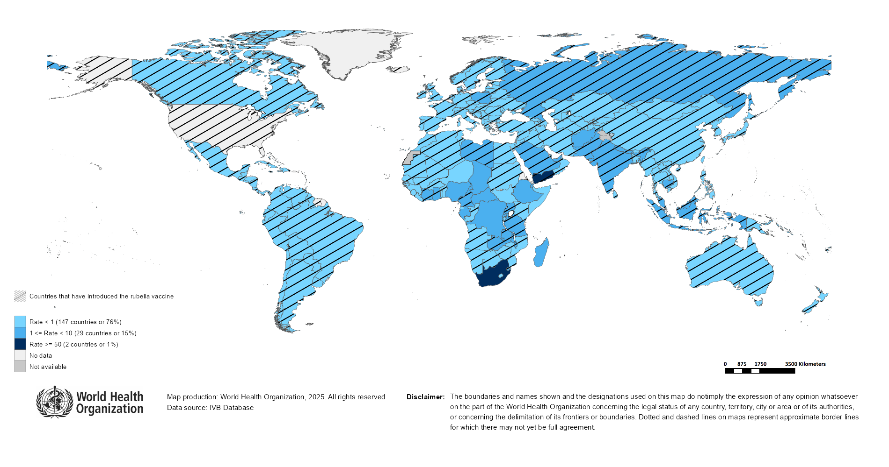
Rubella Incidence Rate per Million (12M period)
Highest incidence rates | Highest incidence rates | Highest incidence rates
Country | Cases | Rate
South Africa | 12067 | 188.53
Yemen | 2299 | 56.65
Chad | 150 | 7.39
Central African Republic | 24 | 4.50
Gabon | 11 | 4.33
DR Congo | 383 | 3.50
Libya | 25 | 3.39
United Republic of Tanzania | 222 | 3.24
Russian Federation | 458 | 3.16
Madagascar | 94 | 2.94
Notes: Based on data received 2025-08 - Surveillance data from 2025-01 to 2025-06 - Incidence: Number of cases / population * 1,000,000 - Population data: World population prospects, 2019 revision

Slide 47
Disclaimer
This document contains data provided to WHO by member states. Note that some member states only provide aggregate data to WHO, and for these, we are unable to generate a country profile. Some member states report all cases at one time point for the entire year, and thus epidemiologic curves generated are not accurate and a reporting artifact. For some countries, cases are reported by age category, not by exact age in months and/or years. Thus, age distribution/incidence is approximate. Cases classified as pending by countries are classified at WHO as clinically compatible at this time, and thus numbers might different between data shown here and provided by the member state or WHO country/regional offices.
*UN population data is used as the denominator for calculating incidence.

Slide 48
Rubella cases (AFR)
AFR Rubella Case Distribution (January 2023-August 2025)
Top 10 countries (last 12 M) | Top 10 countries (last 12 M) | Top 10 countries (last 12 M) | Top 10 countries (last 12 M)
Country | RCV in RI | Cases | % of Total
South Africa | No | 11871 | 84
Nigeria | No | 638 | 5
Ethiopia | No | 385 | 3
DR Congo | No | 368 | 3
Others | - | 278 | 2
United Republic of Tanzania | 2014 | 188 | 1
Chad | No | 150 | 1
Madagascar | No | 83 | 1
Uganda | 2019 | 52 | 0
Malawi | 2017 | 46 | 0
Ghana | 2013 | 39 | 0
2023
2024
2025
4,000
3,000
(lab + epi-linked + clinical)
Number of cases
2,000
1,000
0
Jan
Feb
Mar
Apr
May
Jun
Jul
Aug
Sep
Oct
Nov
Dec
Jan
Feb
Mar
Apr
May
Jun
Jul
Aug
Sep
Oct
Nov
Dec
Jan
Feb
Mar
Apr
May
Jun
Jul
Aug
Sep
Oct
Nov
Dec
Introduced less than 5 years ago
Introduced more than 5 years ago
Not introduced in EPI
(after 2020)
(2020 and before)
AFR Age distribution of Rubella IgM+ cases by vaccine introduction status in the National EPI Programme (last 12 Months)
1500
1000
(IgM+ only)
Number of cases
500
0
0
10
20
30
40
Age at onset (in years)
Rubella vaccine introduced before 1 January 2025
Rubella vaccine not introduced before 1 January 2025
Notes: Based on data received 2025-08 Data Source: IVB Database.

Slide 49
Rubella cases: Democratic Republic of the Congo
ELIMINATION STATUS:
ENDEMIC
2022
2023
2024
2025
Total = 1,237 cases
Total = 594 cases
Total = 300 cases
Total = 241 cases
200
Rubella cases
100
0
Jan
Feb
Mar
Apr
May
Jun
Jul
Aug
Sep
Oct
Nov
Dec
Jan
Feb
Mar
Apr
May
Jun
Jul
Aug
Sep
Oct
Nov
Dec
Jan
Feb
Mar
Apr
May
Jun
Jul
Aug
Sep
Oct
Nov
Dec
Jan
Feb
Mar
Apr
May
Jun
Jul
Aug
Sep
Oct
Nov
Dec
Clinical
Epi
Lab
Age distribution, sex and incidence (Last 12 months)
WHO/UNICEF Coverage Estimates (WUENIC)
150
100
9
80
100
6
Number of cases
Incidence rate per M
60
50
3
% Coverage
40
0
0
20
<1 yr
1-4 yrs
5-9 yrs
10-14 yrs
15-24 yrs
25-39 yrs
40+ yrs
0
Age at onset (in years)
2000
2001
2002
2003
2004
2005
2006
2007
2008
2009
2010
2011
2012
2013
2014
2015
2016
2017
2018
2019
2020
2021
2022
2023
2024
Incidence
Male
Female
Unknown
RCV1

Slide 50
Rubella cases: Ethiopia
ELIMINATION STATUS:
ENDEMIC
300
2022
2023
2024
2025
Total = 698 cases
Total = 930 cases
Total = 242 cases
Total = 334 cases
200
Rubella cases
100
0
Jan
Feb
Mar
Apr
May
Jun
Jul
Aug
Sep
Oct
Nov
Dec
Jan
Feb
Mar
Apr
May
Jun
Jul
Aug
Sep
Oct
Nov
Dec
Jan
Feb
Mar
Apr
May
Jun
Jul
Aug
Sep
Oct
Nov
Dec
Jan
Feb
Mar
Apr
May
Jun
Jul
Aug
Sep
Oct
Nov
Dec
Clinical
Epi
Lab
Age distribution, sex and incidence (Last 12 months)
WHO/UNICEF Coverage Estimates (WUENIC)
12.5
100
150
10.0
80
100
7.5
Number of cases
Incidence rate per M
60
5.0
% Coverage
50
2.5
40
0
0.0
20
<1 yr
1-4 yrs
5-9 yrs
10-14 yrs
15-24 yrs
25-39 yrs
40+ yrs
0
Age at onset (in years)
2000
2001
2002
2003
2004
2005
2006
2007
2008
2009
2010
2011
2012
2013
2014
2015
2016
2017
2018
2019
2020
2021
2022
2023
2024
Incidence
Male
Female
Unknown
RCV1

Slide 51
Rubella cases: Nigeria
ELIMINATION STATUS:
ENDEMIC
2022
2023
2024
2025
300
Total = 895 cases
Total = 740 cases
Total = 651 cases
Total = 543 cases
200
Rubella cases
100
0
Jan
Feb
Mar
Apr
May
Jun
Jul
Aug
Sep
Oct
Nov
Dec
Jan
Feb
Mar
Apr
May
Jun
Jul
Aug
Sep
Oct
Nov
Dec
Jan
Feb
Mar
Apr
May
Jun
Jul
Aug
Sep
Oct
Nov
Dec
Jan
Feb
Mar
Apr
May
Jun
Jul
Aug
Sep
Oct
Nov
Dec
Clinical
Epi
Lab
Age distribution, sex and incidence (Last 12 months)
WHO/UNICEF Coverage Estimates (WUENIC)
200
8
100
150
6
80
100
Incidence rate per M
60
Number of cases
4
% Coverage
50
2
40
0
0
20
<1 yr
1-4 yrs
5-9 yrs
10-14 yrs
15-24 yrs
25-39 yrs
40+ yrs
0
Age at onset (in years)
2000
2001
2002
2003
2004
2005
2006
2007
2008
2009
2010
2011
2012
2013
2014
2015
2016
2017
2018
2019
2020
2021
2022
2023
2024
Incidence
Male
Female
Unknown
RCV1

Slide 52
Rubella cases (EMR)
EMR Rubella Case Distribution (January 2023-August 2025)
Top 10 countries (last 12 M) | Top 10 countries (last 12 M) | Top 10 countries (last 12 M) | Top 10 countries (last 12 M)
Country | RCV in RI | Cases | % of Total
Yemen | 2015 | 2114 | 80
Pakistan | 2022 | 237 | 9
Afghanistan | No | 107 | 4
Saudi Arabia | 1982 | 38 | 1
Others | - | 36 | 1
Sudan | 2024 | 36 | 1
Egypt | 1999 | 25 | 1
Libya | 1993 | 23 | 1
Syrian Arab Republic | 1999 | 17 | 1
Iran (Islamic Republic of) | 2004 | 11 | 0
United Arab Emirates | 1985 | 11 | 0
400
2023
2024
2025
300
(lab + epi-linked + clinical)
200
Number of cases
100
0
Jan
Feb
Mar
Apr
May
Jun
Jul
Aug
Sep
Oct
Nov
Dec
Jan
Feb
Mar
Apr
May
Jun
Jul
Aug
Sep
Oct
Nov
Dec
Jan
Feb
Mar
Apr
May
Jun
Jul
Aug
Sep
Oct
Nov
Dec
Introduced less than 5 years ago
Introduced more than 5 years ago
Not introduced in EPI
(after 2020)
(2020 and before)
EMR Age distribution of Rubella IgM+ cases by vaccine introduction status in the National EPI Programme (last 12 Months)
500
400
300
(IgM+ only)
Number of cases
200
100
0
0
10
20
30
40
Age at onset (in years)
Rubella vaccine introduced before 1 January 2025
Rubella vaccine not introduced before 1 January 2025
Notes: Based on data received 2025-08 Data Source: IVB Database.

Slide 53
Rubella cases: Pakistan
ELIMINATION STATUS:
ENDEMIC
2022
2023
2024
2025
60
Total = 309 cases
Total = 236 cases
Total = 330 cases
Total = 171 cases
40
Rubella cases
20
0
Jan
Feb
Mar
Apr
May
Jun
Jul
Aug
Sep
Oct
Nov
Dec
Jan
Feb
Mar
Apr
May
Jun
Jul
Aug
Sep
Oct
Nov
Dec
Jan
Feb
Mar
Apr
May
Jun
Jul
Aug
Sep
Oct
Nov
Dec
Jan
Feb
Mar
Apr
May
Jun
Jul
Aug
Sep
Oct
Nov
Dec
Clinical
Epi
Lab
Age distribution, sex and incidence (Last 12 months)
WHO/UNICEF Coverage Estimates (WUENIC)
100
90
10
80
60
Incidence rate per M
60
Number of cases
30
5
% Coverage
40
0
0
20
<1 yr
1-4 yrs
5-9 yrs
10-14 yrs
15-24 yrs
25-39 yrs
40+ yrs
0
Age at onset (in years)
2000
2001
2002
2003
2004
2005
2006
2007
2008
2009
2010
2011
2012
2013
2014
2015
2016
2017
2018
2019
2020
2021
2022
2023
2024
Incidence
Male
Female
Unknown
RCV1

Slide 54
Rubella cases (EUR)
EUR Rubella Case Distribution (January 2023-August 2025)
Top 10 countries (last 12 M) | Top 10 countries (last 12 M) | Top 10 countries (last 12 M) | Top 10 countries (last 12 M)
Country | RCV in RI | Cases | % of Total
Russian Federation | 2000 | 429 | 81
Poland | 1988 | 45 | 8
Türkiye | 2006 | 19 | 4
Ukraine | 2003 | 10 | 2
Germany | 1991 | 9 | 2
Kyrgyzstan | 2001 | 4 | 1
Sweden | 1982 | 4 | 1
Kazakhstan | 2004 | 3 | 1
Others | - | 3 | 1
Uzbekistan | 2006 | 3 | 1
Italy | 1972 | 2 | 0
2023
2024
2025
90
60
(lab + epi-linked + clinical)
Number of cases
30
0
Jan
Feb
Mar
Apr
May
Jun
Jul
Aug
Sep
Oct
Nov
Dec
Jan
Feb
Mar
Apr
May
Jun
Jul
Aug
Sep
Oct
Nov
Dec
Jan
Feb
Mar
Apr
May
Jun
Jul
Aug
Sep
Oct
Nov
Dec
Introduced more than 5 years ago
(2020 and before)
EUR Age distribution of Rubella IgM+ cases by vaccine introduction status in the National EPI Programme (last 12 Months)
20
15
(IgM+ only)
10
Number of cases
5
0
0
10
20
30
40
Age at onset (in years)
Rubella vaccine introduced before 1 January 2025
Rubella vaccine not introduced before 1 January 2025
Notes: Based on data received 2025-08 Data Source: IVB Database. Spikes in age-distribution curve are an artifact of reporting by age bands ( 0=<1 yrs, 2=1-4 yrs, 7=5-9 yrs, 12=10-14 yrs, 17=15-19 yrs, 25=20-29 yrs, 45=30+yrs) instead of by age from some member states.

Slide 55
Rubella cases (SEAR (excl. India))
SEAR (excl. India) Rubella Case Distribution (January 2023-August 2025)
Top 10 countries (last 12 M) | Top 10 countries (last 12 M) | Top 10 countries (last 12 M) | Top 10 countries (last 12 M)
Country | RCV in RI | Cases | % of Total
Bangladesh | 2012 | 68 | 50
Nepal | 2013 | 40 | 29
Thailand | 1997 | 24 | 18
Myanmar | 2015 | 5 | 4
2023
2024
2025
60
40
(lab + epi-linked + clinical)
Number of cases
20
0
Jan
Feb
Mar
Apr
May
Jun
Jul
Aug
Sep
Oct
Nov
Dec
Jan
Feb
Mar
Apr
May
Jun
Jul
Aug
Sep
Oct
Nov
Dec
Jan
Feb
Mar
Apr
May
Jun
Jul
Aug
Sep
Oct
Nov
Dec
Introduced more than 5 years ago
(2020 and before)
SEAR (excl. India) Age distribution of Rubella IgM+ cases by vaccine introduction status in the National EPI Programme (last 12 Months)
60
40
(IgM+ only)
Number of cases
20
0
0
10
20
30
40
Age at onset (in years)
Rubella vaccine introduced before 1 January 2025
Rubella vaccine not introduced before 1 January 2025
Notes: Based on data received 2025-08 Data Source: IVB Database.

Slide 56
Rubella cases (SEAR, India)
SEAR, India Rubella Case Distribution (January 2023-August 2025)
Top 10 countries (last 12 M) | Top 10 countries (last 12 M) | Top 10 countries (last 12 M) | Top 10 countries (last 12 M)
Country | RCV in RI | Cases | % of Total
India | 2018 | 2476 | 100
2023
2024
2025
300
200
(lab + epi-linked + clinical)
Number of cases
100
0
Jan
Feb
Mar
Apr
May
Jun
Jul
Aug
Sep
Oct
Nov
Dec
Jan
Feb
Mar
Apr
May
Jun
Jul
Aug
Sep
Oct
Nov
Dec
Jan
Feb
Mar
Apr
May
Jun
Jul
Aug
Sep
Oct
Nov
Dec
Introduced more than 5 years ago
(2020 and before)
SEAR, India Age distribution of Rubella IgM+ cases by vaccine introduction status in the National EPI Programme (last 12 Months)
600
400
(IgM+ only)
Number of cases
200
0
0
10
20
30
40
Age at onset (in years)
Rubella vaccine introduced before 1 January 2025
Rubella vaccine not introduced before 1 January 2025
Notes: Based on data received 2025-08 Data Source: IVB Database.

Slide 57
Rubella cases: India
ELIMINATION STATUS:
ENDEMIC
2022
2023
2024
2025
500
Total = 2,559 cases
Total = 2,930 cases
Total = 2,522 cases
Total = 1,486 cases
400
300
Rubella cases
200
100
0
Jan
Feb
Mar
Apr
May
Jun
Jul
Aug
Sep
Oct
Nov
Dec
Jan
Feb
Mar
Apr
May
Jun
Jul
Aug
Sep
Oct
Nov
Dec
Jan
Feb
Mar
Apr
May
Jun
Jul
Aug
Sep
Oct
Nov
Dec
Jan
Feb
Mar
Apr
May
Jun
Jul
Aug
Sep
Oct
Nov
Dec
Clinical
Epi
Lab
Age distribution, sex and incidence (Last 12 months)
WHO/UNICEF Coverage Estimates (WUENIC)
30
100
750
80
500
20
Number of cases
Incidence rate per M
60
250
10
% Coverage
40
0
0
20
<1 yr
1-4 yrs
5-9 yrs
10-14 yrs
15-24 yrs
25-39 yrs
40+ yrs
0
Age at onset (in years)
2000
2001
2002
2003
2004
2005
2006
2007
2008
2009
2010
2011
2012
2013
2014
2015
2016
2017
2018
2019
2020
2021
2022
2023
2024
Incidence
Male
Female
Unknown
RCV1

Slide 58
Rubella cases (WPR)
WPR Rubella Case Distribution (January 2023-August 2025)
Top 10 countries (last 12 M) | Top 10 countries (last 12 M) | Top 10 countries (last 12 M) | Top 10 countries (last 12 M)
Country | RCV in RI | Cases | % of Total
China | 2008 | 389 | 40
Indonesia | 2018 | 377 | 38
Malaysia | 2004 | 80 | 8
Philippines | 2010 | 70 | 7
Cambodia | 2013 | 40 | 4
Japan | 1995 | 14 | 1
Viet Nam | 2015 | 13 | 1
Singapore | 1982 | 1 | 0
2023
2024
2025
160
120
(lab + epi-linked + clinical)
Number of cases
80
40
0
Jan
Feb
Mar
Apr
May
Jun
Jul
Aug
Sep
Oct
Nov
Dec
Jan
Feb
Mar
Apr
May
Jun
Jul
Aug
Sep
Oct
Nov
Dec
Jan
Feb
Mar
Apr
May
Jun
Jul
Aug
Sep
Oct
Nov
Dec
Introduced more than 5 years ago
(2020 and before)
WPR Age distribution of Rubella IgM+ cases by vaccine introduction status in the National EPI Programme (last 12 Months)
150
100
(IgM+ only)
Number of cases
50
0
0
10
20
30
40
Age at onset (in years)
Rubella vaccine introduced before 1 January 2025
Rubella vaccine not introduced before 1 January 2025
Notes: Based on data received 2025-08 Data Source: IVB Database.

Slide 59
Rubella cases: Indonesia
ELIMINATION STATUS:
ENDEMIC
2022
2023
2024
2025
150
Total = 755 cases
Total = 477 cases
Total = 457 cases
Total = 192 cases
100
Rubella cases
50
0
Jan
Feb
Mar
Apr
May
Jun
Jul
Aug
Sep
Oct
Nov
Dec
Jan
Feb
Mar
Apr
May
Jun
Jul
Aug
Sep
Oct
Nov
Dec
Jan
Feb
Mar
Apr
May
Jun
Jul
Aug
Sep
Oct
Nov
Dec
Jan
Feb
Mar
Apr
May
Jun
Jul
Aug
Sep
Oct
Nov
Dec
Clinical
Epi
Lab
Age distribution, sex and incidence (Last 12 months)
WHO/UNICEF Coverage Estimates (WUENIC)
60
100
10
80
40
Incidence rate per M
60
Number of cases
20
5
% Coverage
40
0
0
20
<1 yr
1-4 yrs
5-9 yrs
10-14 yrs
15-24 yrs
25-39 yrs
40+ yrs
0
Age at onset (in years)
2000
2001
2002
2003
2004
2005
2006
2007
2008
2009
2010
2011
2012
2013
2014
2015
2016
2017
2018
2019
2020
2021
2022
2023
2024
Incidence
Male
Female
Unknown
RCV1

Slide 60

Distribution of rubella genotypes (last 12 months)
Data Source: RUBENS2 database (Genotypes) and IVB Database (Incidence) as of 2025-08-18 and covering the period between 2024-07 and 2025-06 - Pie charts proportional to the number of sequenced viruses

Slide 61
Laboratory

Slide 62
Measles and Rubella IgM Data Summary
2025
Region | Member States* | Specimens received | Measles tested | Measles positive n(%) | Measles equivocal n(%) | Measles negative n(%) | Rubella tested | Rubella positive n(%) | Rubella equivocal n(%) | Rubella negative n(%)
AFR | 44/47 | 57,461 | 50,275 | 16,253 (32) | 1,035 (2) | 28,737 (57) | 32,521 | 2,210 (7) | 400 (1) | 25,619 (79)
AMR | 26/35 | 8,232 | 8,111 | 1,746 (22) | 219 (3) | 6,146 (76) | 7,921 | 191 (2) | 82 (1) | 7,648 (97)
EMR | 20/21 | 74,307 | 48,762 | 20,606 (42) | 24 (0) | 28,132 (58) | 41,983 | 676 (2) | 21 (0) | 41,286 (98)
EUR | 42/53 | 25,884 | 23,249 | 10,824 (47) | 117 (1) | 14,317 (62) | 10,370 | 673 (6) | 81 (1) | 9,630 (93)
SEAR | 10/10 | 48,625 | 46,078 | 4,645 (10) | 532 (1) | 40,875 (89) | 45,815 | 1,391 (3) | 379 (1) | 44,040 (96)
WPR | 26/28 | 23,272 | 22,369 | 6,292 (28) | 531 (2) | 15,523 (69) | 18,707 | 552 (3) | 100 (1) | 18,051 (96)
Total | 168/194 | 237,781 | 198,844 | 60,366 (30) | 2,458 (1) | 133,730 (67) | 157,317 | 5,693 (4) | 1,063 (1) | 146,274 (93)
2024
Region | Member States* | Specimens received | Measles tested | Measles positive n(%) | Measles equivocal n(%) | Measles negative n(%) | Rubella tested | Rubella positive n(%) | Rubella equivocal n(%) | Rubella negative n(%)
AFR | 43/47 | 120,445 | 109,377 | 19,102 (17) | 1,068 (1) | 61,018 (56) | 95,315 | 14,882 (16) | 465 (0) | 51,744 (54)
AMR | 29/35 | 7,968 | 8,286 | 353 (4) | 203 (2) | 7,730 (93) | 7,359 | 170 (2) | 98 (1) | 7,091 (96)
EMR | 21/21 | 116,666 | 98,271 | 38,273 (39) | 129 (0) | 59,869 (61) | 90,051 | 1,468 (2) | 77 (0) | 88,506 (98)
EUR | 44/53 | 159,496 | 137,242 | 78,299 (57) | 404 (0) | 53,578 (39) | 56,088 | 1,305 (2) | 363 (1) | 54,154 (97)
SEAR | 10/10 | 107,502 | 105,552 | 13,353 (13) | 1,097 (1) | 90,993 (86) | 101,445 | 2,551 (3) | 691 (1) | 98,203 (97)
WPR | 26/28 | 46,024 | 44,029 | 11,240 (26) | 3,086 (7) | 33,538 (76) | 33,773 | 1,137 (3) | 2,437 (7) | 32,463 (96)
Total | 173/194 | 558,101 | 502,757 | 160,620 (32) | 5,987 (1) | 306,726 (61) | 384,031 | 21,513 (6) | 4,131 (1) | 332,161 (86)
Notes: Based on data received 2025-08 - * Member States Reporting / Total Member States in Region

Slide 63
Supplementary Immunization Activities

Slide 64
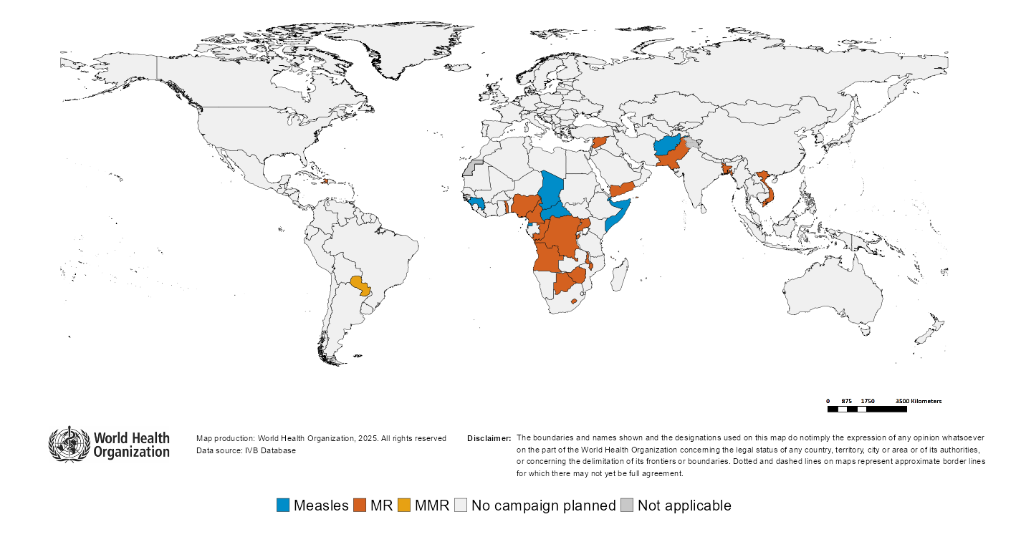
Upcoming MMR, MR and Measles campaigns (2025-2026)

Slide 65
Upcoming MMR, MR and Measles campaigns (2025-2026)
Year | Region | Name | Type | Intervention | StartDate | Status | Age Group(s) | Extent | Target
2025 | AFR | Guinea | SNID | MEASLES | 2025-02-?? | Planned | 0-59 M | SUBNATIONAL | 996214
2025 | AFR | Central African Republic | FollowUp | MEASLES | 2025-10-?? | Planned | 6-59 M | NATIONAL | 1335862
2025 | AFR | Congo | FollowUp | MR | 2025-10-?? | Planned | 9-59 M | NATIONAL | 927595
2025 | AFR | Gambia | FollowUp | MR | 2025-10-?? | Planned | 9-59 M | NATIONAL | 385713
2025 | AFR | Nigeria | CatchUp-SIA | MR | 2025-10-?? | Planned | 9 M-14 Y | NATIONAL | 102539762
2025 | AFR | Zimbabwe | FollowUp | MR | 2025-10-06 | Planned | 9-59 M | NATIONAL | 2518935
2025 | AFR | Lesotho | CatchUp-SIA | MR | 2025-10-22 | Planned | 9-59 M | NATIONAL | 188518
2025 | AFR | Botswana | FollowUp | MR | 2025-11-?? | Planned | 9-59 M | NATIONAL | 223959
2025 | AFR | Chad | FollowUp | MEASLES | 2025-11-?? | Planned | 9-59 M | NATIONAL | 3772072
2025 | AFR | Comoros | FollowUp | MR | 2025-11-?? | Planned | 9-59 M | NATIONAL | 113688
2025 | AFR | Togo | FollowUp | MR | 2025-11-?? | Planned | 9 M-9 Y | NATIONAL | 2201427
2025 | AFR | Uganda | FollowUp | MR | 2025-11-?? | Planned | 9-59 M | NATIONAL | 7685529
2025 | AFR | Democratic Republic of the Congo | CatchUp | MR | 2025-11-26 | Planned | 9 M-14 Y | NATIONAL | 61697195
2025 | AMR | Turks and Caicos Islands | VaccinationWeek | MMR | 2025-04-?? | Planned | 5-14 Y | NATIONAL | 100
2025 | EMR | Syrian Arab Republic | FollowUp | MR | 2025-10-?? | Planned | 9-59 M | NATIONAL | 1892447
2025 | EMR | Afghanistan | FollowUp | MEASLES | 2025-11-?? | Planned | 9-59 M | NATIONAL | 16047992
2025 | EMR | Pakistan | FollowUp | MR | 2025-11-?? | Planned | 6-59 M | NATIONAL | 35402182
2025 | EMR | Somalia | FollowUp | MEASLES | 2025-NA-?? | Planned | 9-59 M | NATIONAL | 3200130
2025 | WPR | Viet Nam | OR | MR | 2025-01-?? | Planned | 6 M-15 Y | NATIONAL | 2170542
2026 | AFR | Malawi | FollowUp | MR | 2026-04-?? | Planned | 9-59 M | NATIONAL | 5850406
2026 | AFR | Burundi | FollowUp | MR | 2026-10-?? | Planned | 9-59 M | NATIONAL | 2446535
2026 | AFR | Angola | FollowUp | MR | 2026-NA-?? | Planned | 9-59 M | NATIONAL | 5983408
2026 | AFR | Cameroon | FollowUp | MR | 2026-NA-?? | Planned | 9-59 M | NATIONAL | 4345819
2026 | AFR | Equatorial Guinea | FollowUp | MEASLES | 2026-NA-?? | Planned | 9-59 M | NATIONAL | 229691
2026 | AMR | Paraguay | Campaign | MMR | 2026-10-?? | Planned | 12-59 M | NATIONAL | 509698
2026 | AMR | Haiti | Campaign | MR | 2026-NA-?? | Planned | 9-59 M | NATIONAL | 1236480
2026 | EMR | Djibouti | CatchUp | MEASLES | 2026-NA-?? | Planned | 9-59 M | NATIONAL | 340185
2026 | EMR | Yemen | FollowUp | MR | 2026-NA-?? | Planned | 9-59 M | NATIONAL | 4714060
2026 | SEAR | Bangladesh | FollowUp | MR | 2026-01-?? | Planned | 9 M-14 Y | NATIONAL | 19808176

Slide 66
WHO Bulletins and Newsletters

